Slide 1
Opinionnare Strategy Share
Ryan Borden and Ben Spiers

Slide 2
Opinionnare Questions
1. The only goal of an abolitionist is to abolish slavery.
Agree/Strongly Agree/Disagree/Strongly Disagree
Reason:
2. Abraham Lincoln is an abolitionist.
Agree/Strongly Agree/Disagree/Strongly Disagree
Reason:
3. Abolitionists were thrilled with Lincoln’s Emancipation Proclamation.
Agree/Strongly Agree/Disagree/Strongly Disagree
Reason:

Slide 3
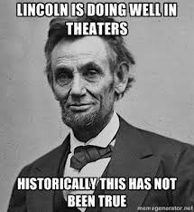
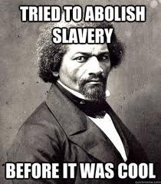
Share your ideas

