Slide 1
Artifact Bag
Ben Spiers

Slide 2
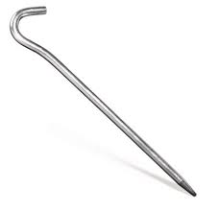
Artifact #1
The tent stake is significant for me because it represents that I enjoy the outdoors. I have been on numerous canoeing, kayaking, hiking, camping, and backpacking trips the last fifteen years. I like to canoe and kayak on the Nottoway River back home. Of note I have been backpacking to Mt. Rogers three times, with the most recent trip being in December 2011. The first time I went there, I got a mild case of hyperthermia.

Slide 3

Artifact #2
This is a book I read several years ago during the summer about the organized partisan command of John Mosby. This book represents my interest in Virginia history and American Civil War history. I have always had a interest in the Civil War as a result of growing up near Civil War sites like Five Forks and Petersburg. There are less well known Civil War sites that I live near as well. I am also a descendant of Civil War veterans.

Slide 4
Artifact #3
My third artifact is a key chain of the twelve disciples of Jesus (one is currently missing off of the key chain) given to me by Grandmother. She received the key chain from her Uncle. The twelve disciples key chain represents the importance of religion in me and my family’s life. My Grandmother and other family members are Baptists. Many of my family members and I have been lifelong Methodists. I have also been on mission trips to places like Eastern North Carolina in March 2012 and Northeastern Alabama in March 2013. Eastern North Carolina was hit hard by Hurricane Irene in August 2011, and Alabama was hit hard by a Tornado Outbreak in April 2011. Both regions also have high levels of poverty.

Slide 5

Artifact #4
This is a book on the Cuban Missile Crisis that I read in Fall 2009 for a Modern America History class. It has been a while since I read the book, but I consider it to be a very good book worth reading. This book represents my interest in more modern history, government, and politics. Topics like the two World Wars, Cold War, Vietnam, and modern political issues interest me.

Slide 6
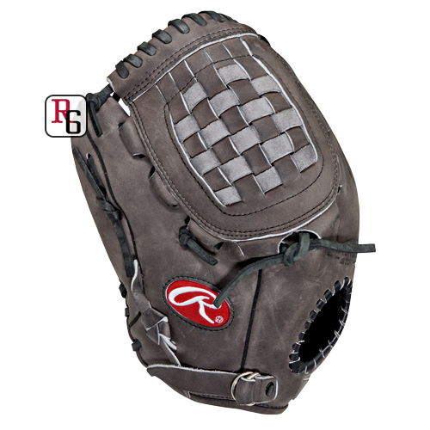
Final Artifact
My baseball glove represents my interest in sports. I enjoy watching and playing sports like football, basketball, and baseball. Out of those three sports, baseball is probably the one I am best at. I played Tee-ball, Dixie Youth and Babe Ruth baseball. In May 2005 I got thrown out of a baseball game after getting thrown out at home plate. This glove also represents that I am left handed.

