Slide 1
My Teaching Journey
Ben Spiers

Slide 2
The Journey Begins
Graduated from Dinwiddie High School in 2008
Earned my Associates of Arts in 2010 from Richard Bland College
Graduated from Virginia Tech in 2012 with a Bachelors of Arts in History, Political Science Minor
Began in the Masters of Education Program in Fall 2012

Slide 3
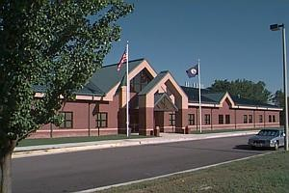
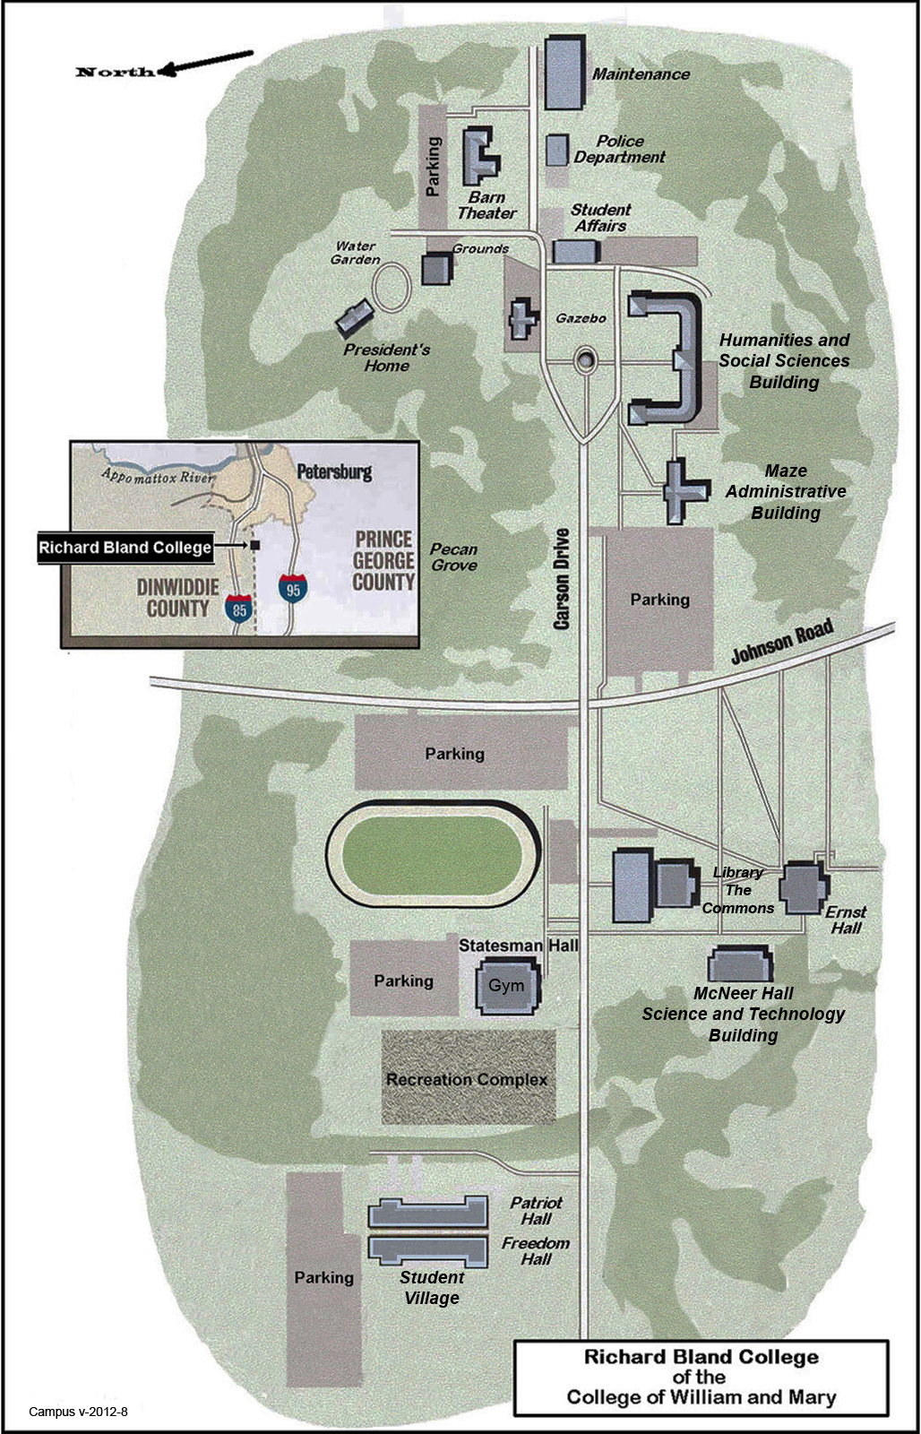
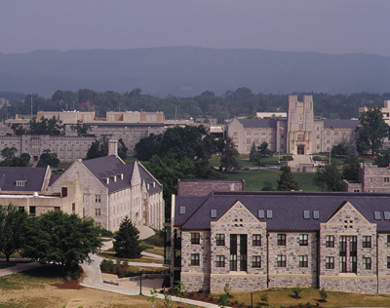

Slide 4
1st YEar
Schooling in American Society
Content Area Reading Literacy
Educating Exceptional Learners
Taking graduate level Political Science Courses

Slide 5
FALL 2013-Spring 2014
Methods I
Assessment
Fall Internship
Eighteen Hours
Methods II
Student Teaching

Slide 6
Fall Internship Activity: Columbian Exchange
Directions: On the next few slides I will show pictures of products, animals, and diseases involved in the Columbian Exchange. You will have to guess through raising hands whether the item went from the Americas to Europe/Africa or Europe/Africa to the Americas through the Columbian Exchange.

Slide 7
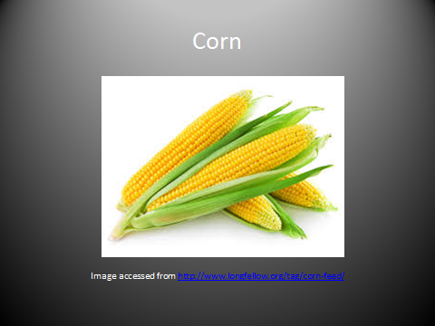

Slide 8
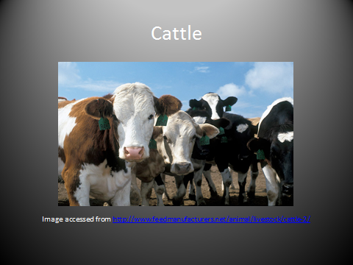

Slide 9
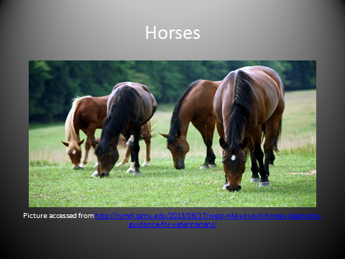

Slide 10
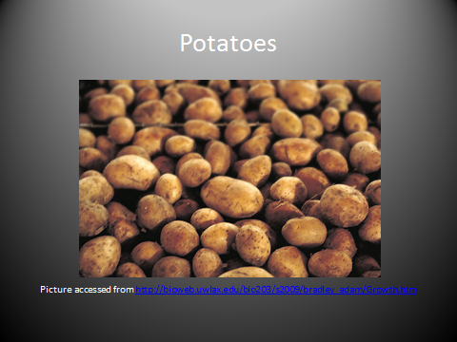

Slide 11
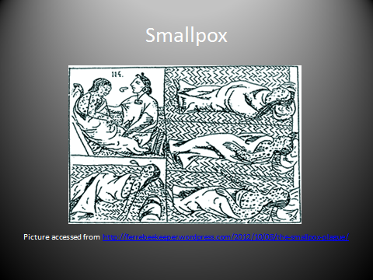

Slide 12
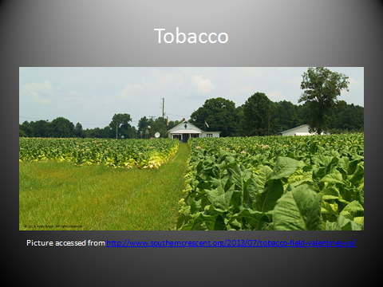

Slide 13
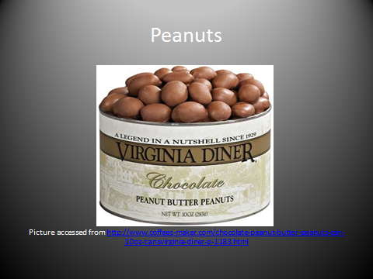

Slide 14
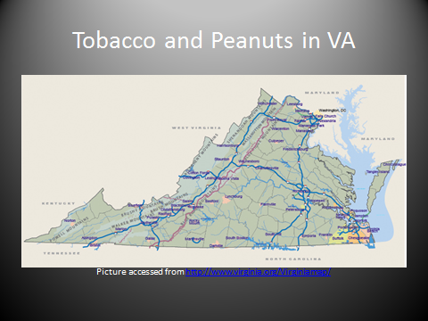

Slide 15
Highlights/Important Events from this Past year

Slide 16
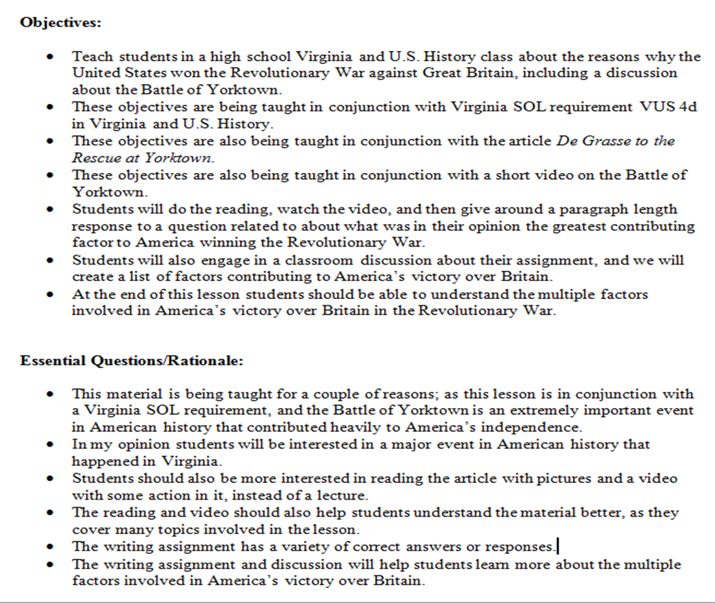
Lesson Plan Progression: Spring 2013

Slide 17
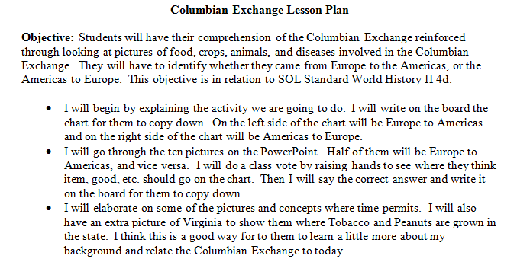
Fall 2013: Columbian Exchange Activity

Slide 18
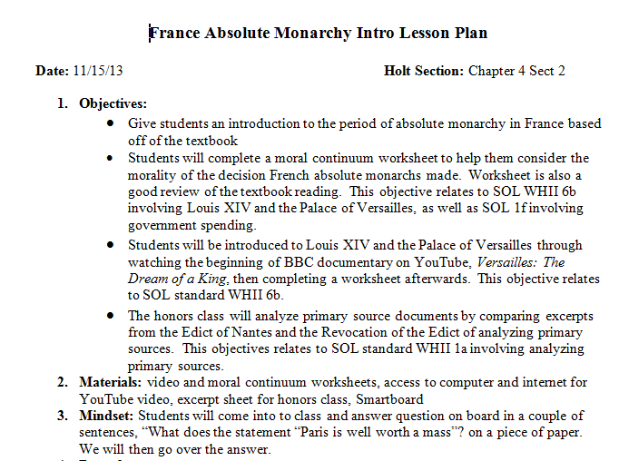
Fall 2013: Full Lesson

Slide 19
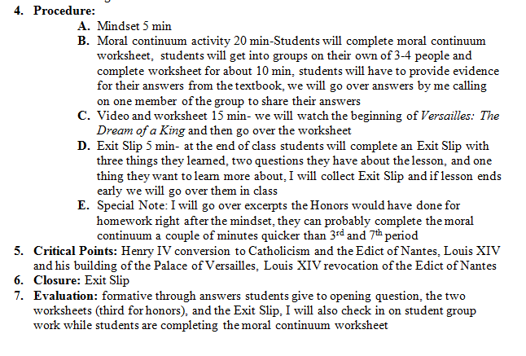
FuLL Lesson Continued

Slide 20
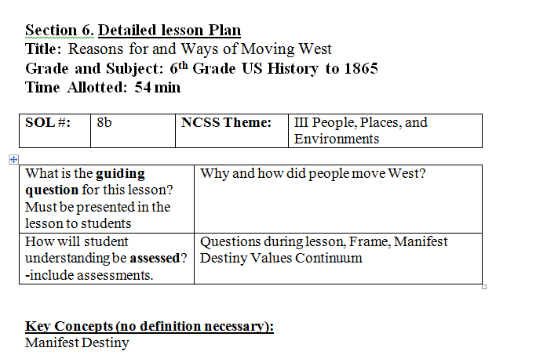
SPRING: 2014 Lesson Plan Example

Slide 21
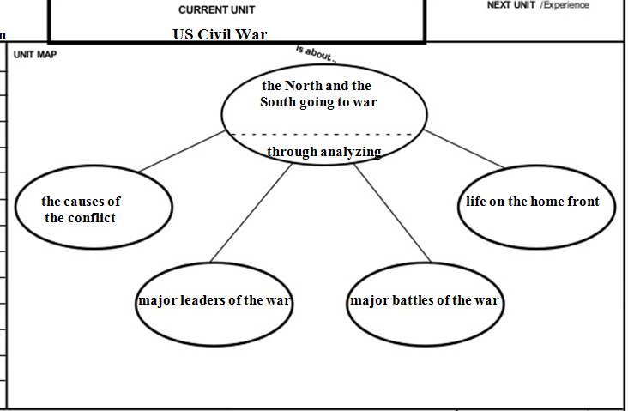
SIM Routines: Unit Organizer

Slide 22
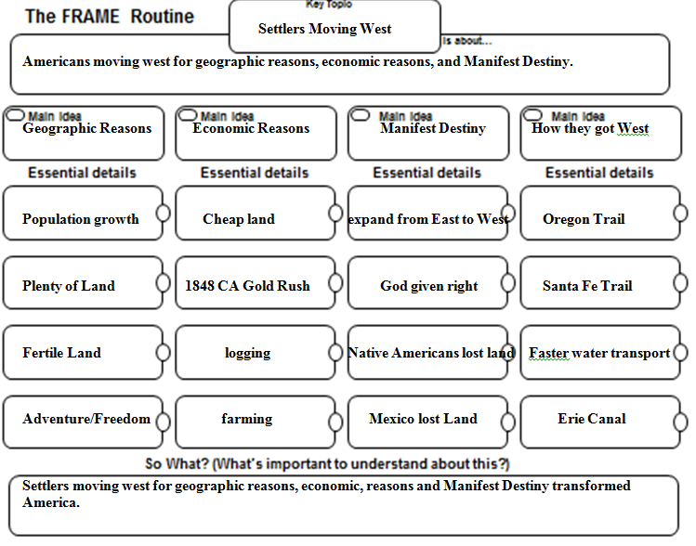
Sim Routines: FRAME

Slide 23
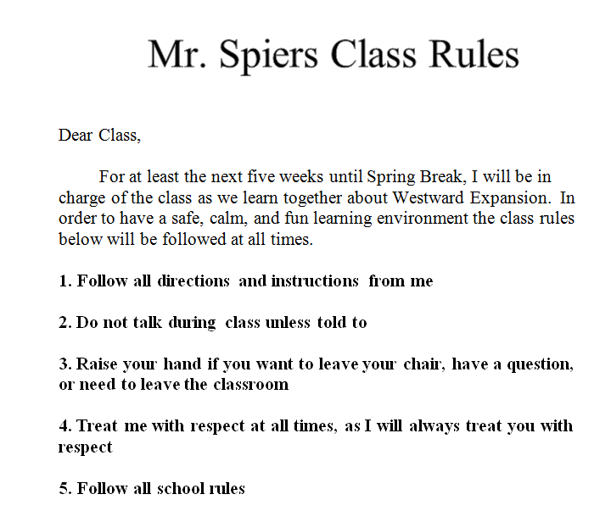
Discipline: Class RUles

Slide 24
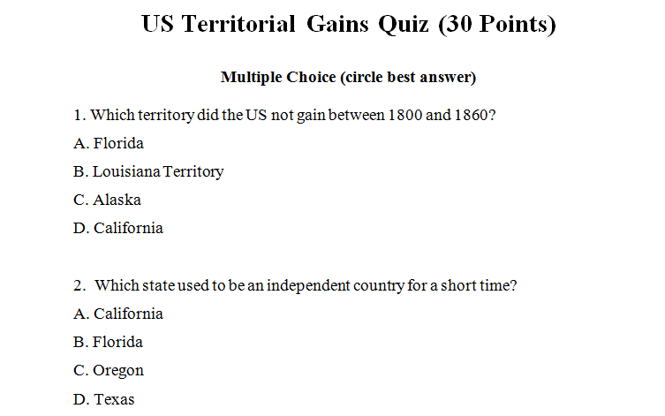
SPRING QUIZ EXAMPLE

Slide 25
Other Major Events/Highlights
Class Syllabus
Blog
Prior Knowledge Paper
Invention Project
SMART Goal Assignment
Test Construction Project

Slide 26
LESSONS: My Strengths
Strong content knowledge
Use a variety of activities
Approachable with students
Good working relationships with colleagues
Review activities

Slide 27
LESSONS: Weaknesses
Technology
Assessment
Understanding student learning development
Discipline

Slide 28
Resources
Dinwiddie Middle School: http://www.dinwiddie.k12.va.us/dms/
Richard Bland Map: http://www2.rbc.edu/campus_map.html
Virginia Tech Image: http://www.vtmag.vt.edu/fall06/feature2.html

