Slide 1
Columbian Exchange
Ben Spiers

Slide 2
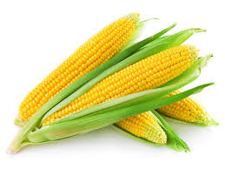
Corn
Image accessed from http://www.longfellow.org/tag/corn-feed/

Slide 3
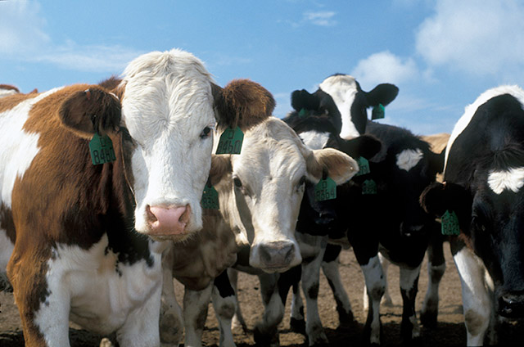
Cattle
Image accessed from http://www.feedmanufacturers.net/animal/livestock/cattle-2/

Slide 4
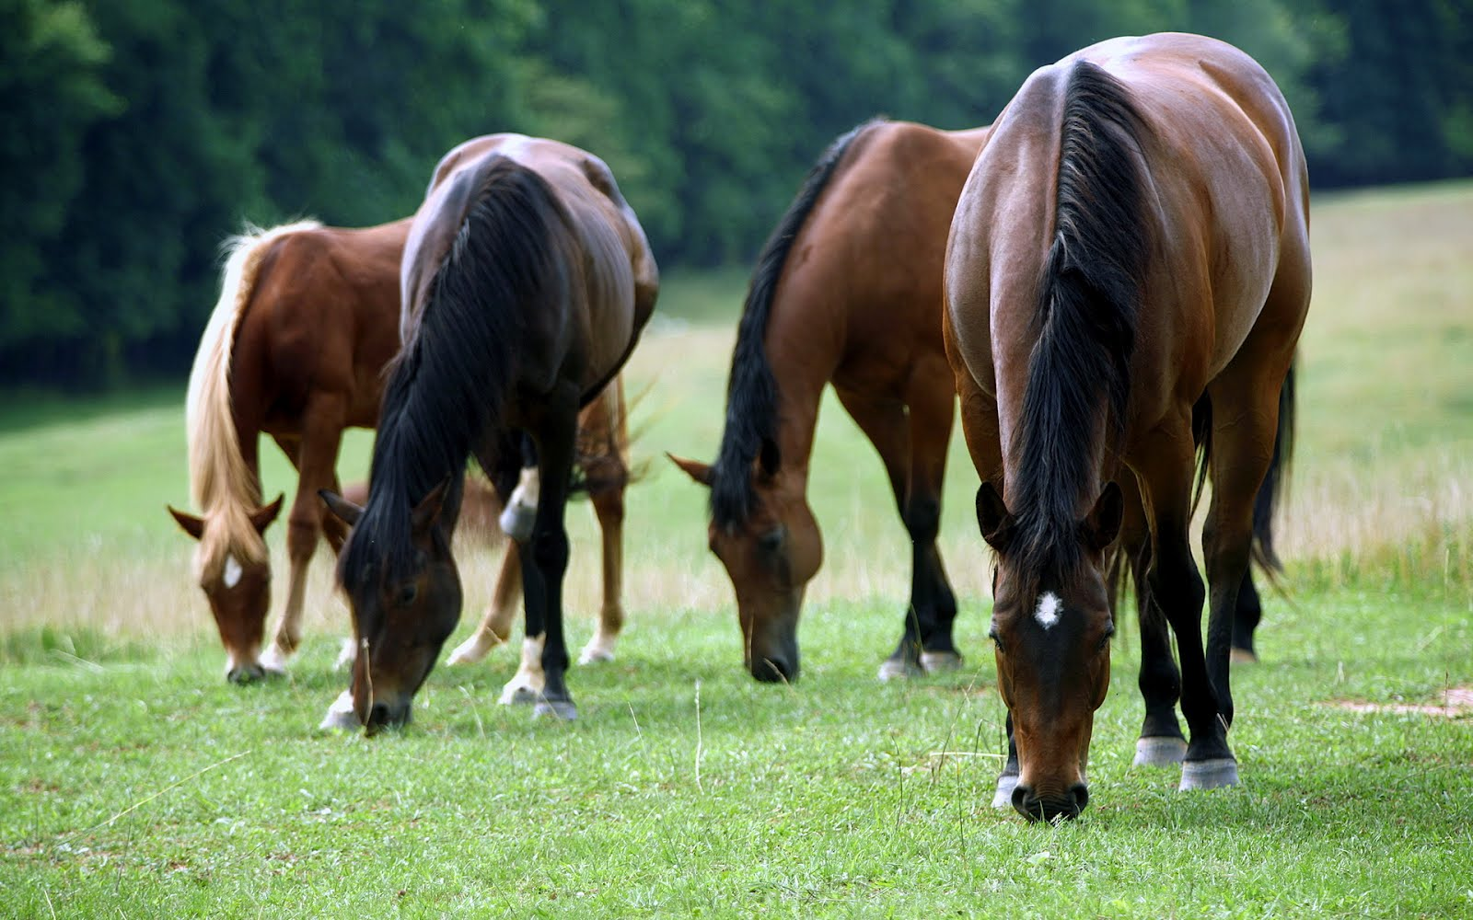
Horses
Picture accessed from http://tvmdl.tamu.edu/2013/06/17/west-nile-virus-in-horses-diagnostic-guidance-for-veterinarians/

Slide 5
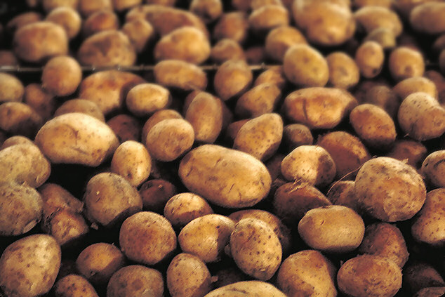
Potatoes
Picture accessed from http://bioweb.uwlax.edu/bio203/s2009/bradley_adam/Growth.htm

Slide 6
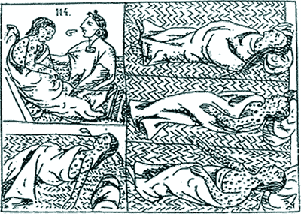
Smallpox
Picture accessed from http://ferrebeekeeper.wordpress.com/2012/10/08/the-smallpox-plague/

Slide 7
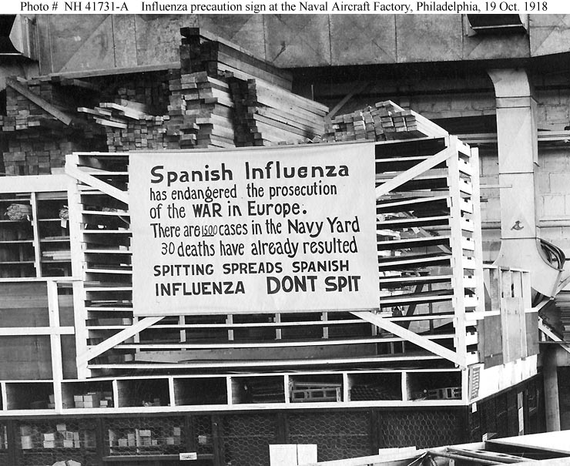
Flu
Picture accessed from http://www.history.navy.mil/photos/events/ev-1910s/ev-1918/influenz.htm

Slide 8
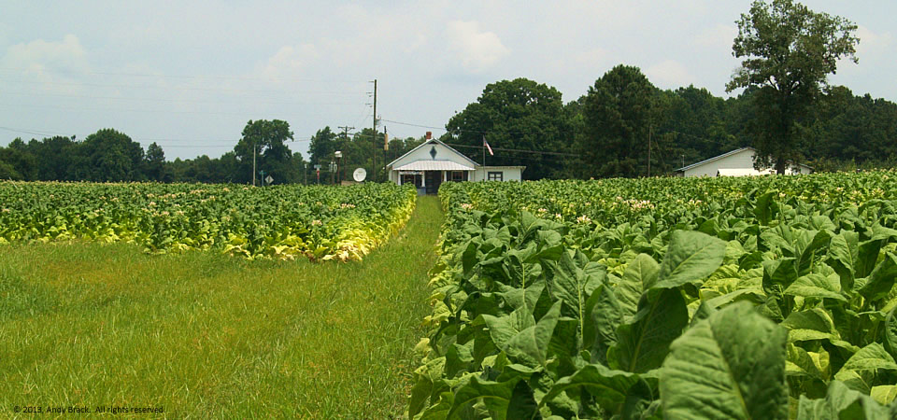
Tobacco
Picture accessed from http://www.southerncrescent.org/2013/07/tobacco-field-valentines-va/

Slide 9
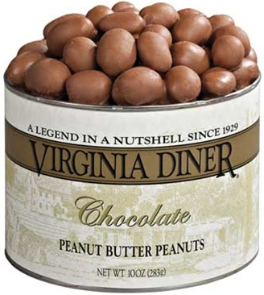
Peanuts
Picture accessed from http://www.coffees-maker.com/chocolate-peanut-butter-peanuts-can-10oz-cansvirginia-diner-p-1183.html

Slide 10
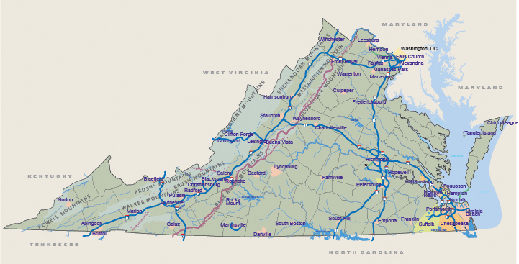
Tobacco and Peanuts in VA
Picture accessed from http://www.virginia.org/Virginiamap/

