Slide 1
U.S. Territorial Gains Overview 1800-1850
Ben Spiers

Slide 2
Lesson Overview
NCSS: II Time, Continuity, and Change
III: People, Places, and Environments
VA SOL: USI 1f) analyze and interpret maps to explain relationships among landforms, water features, climatic characteristics, and historical events
8a) describing territorial expansion and how it affected the political map of the United States, with emphasis on the Louisiana Purchase, the Lewis and Clark expedition, and the acquisitions of Florida, Texas, Oregon, and California
SWBAT:#1 Students will be able to identify which territories the U.S. gained in the first half of the 1800’s.
#2 Students will be able to locate the territories gained on a map.
Big/Guiding Question: What territories did the U.S. gain in the first half of the 1800’s, and why is this significant?

Slide 3
Just Do It: Opening Pictures
Directions: For the opening activity I will show five modern pictures on the next few slides. You will guess what and where the picture is. You do not have to write the answers down and we will come back to these pictures at the end of class.

Slide 4

Picture #1

Slide 5
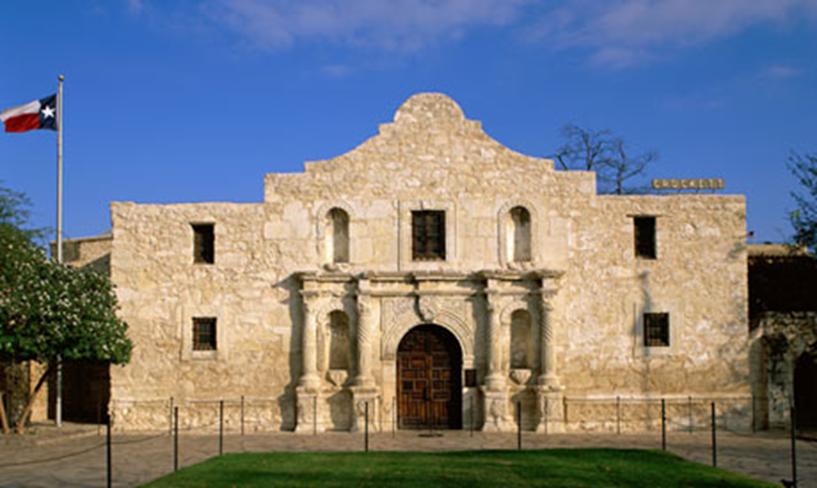
Picture #2

Slide 6
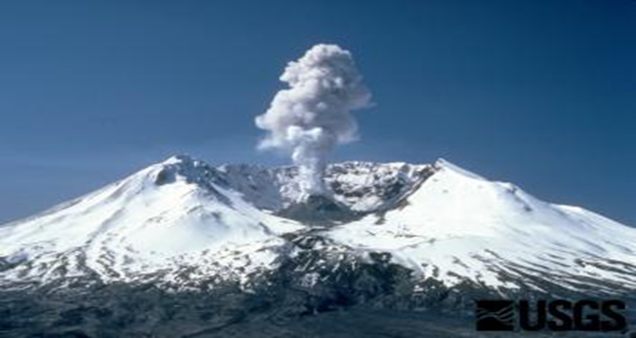
Picture #3

Slide 7
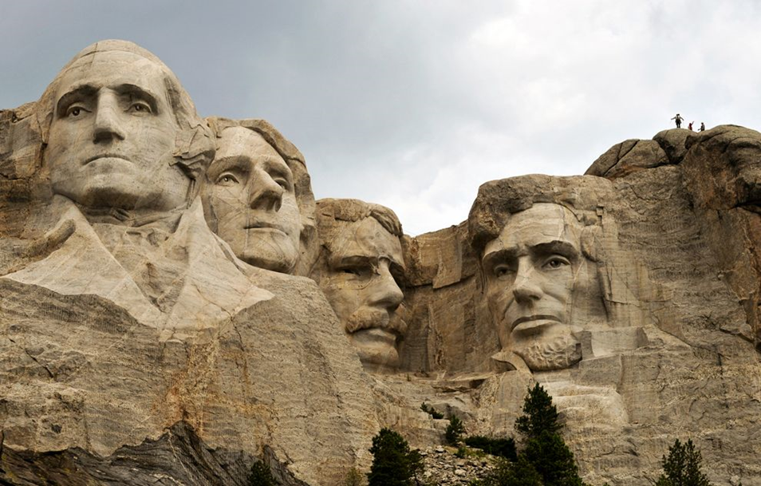
Picture #4

Slide 8
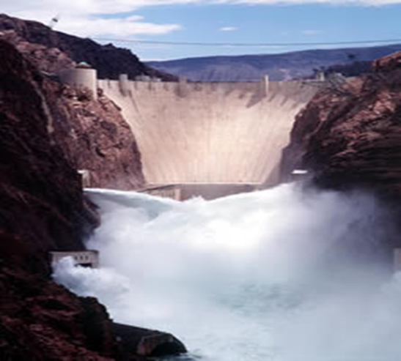
Picture #5

Slide 9
U.S. Territorial Gains 1800-1850 Frame
Directions: Find the Frame on your desk and we will as a class fill them out step-by-step. Your neighbors can also help you out.

Slide 10
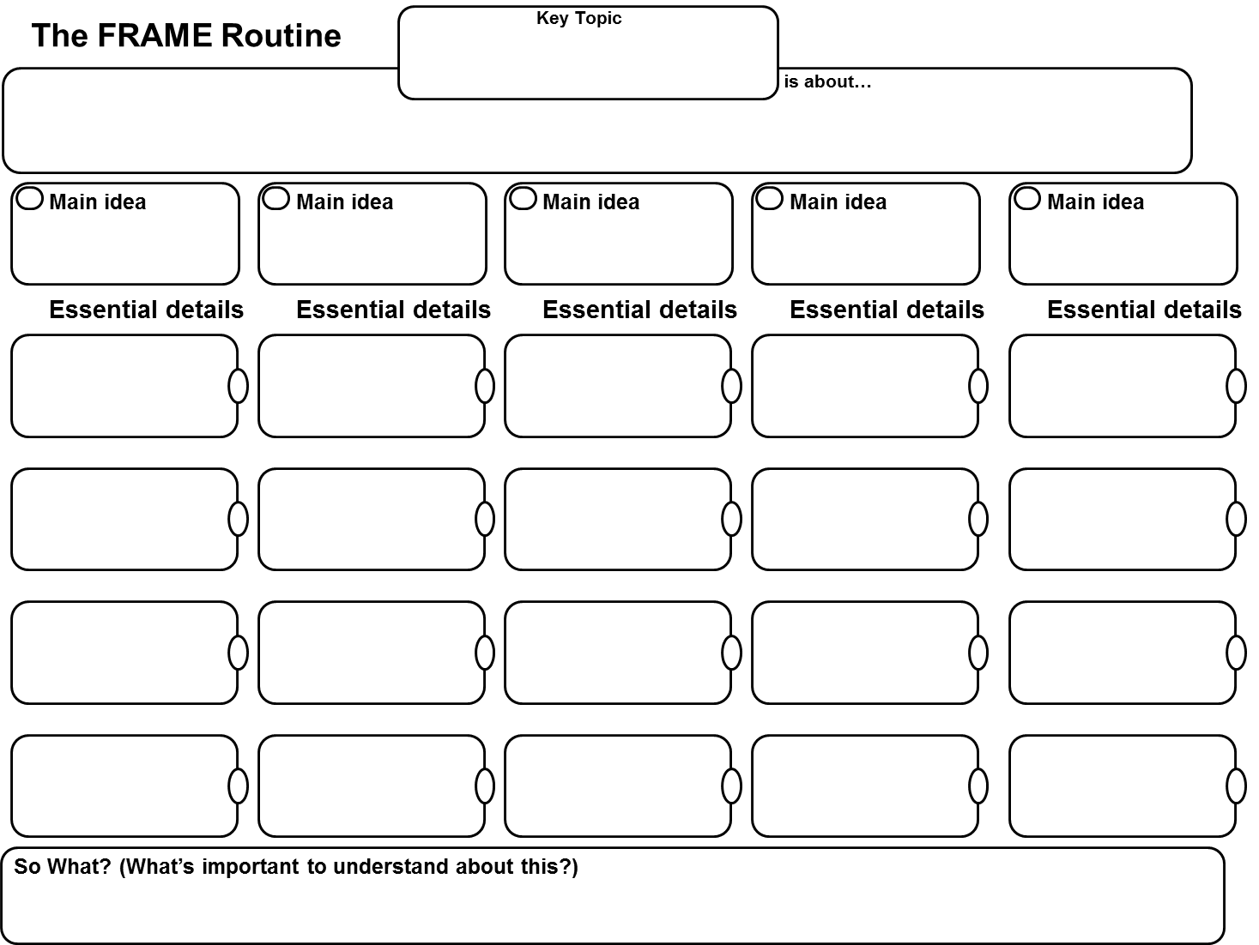

Slide 11
Western US Geography Review
Directions: On the next slide I will have a US map, and I call students to come up to the front to identify major geographic features on the map like bodies of water, regions, and mountain ranges. This is a review from earlier in the year and you can write where the features are on your map if you want to.

Slide 12
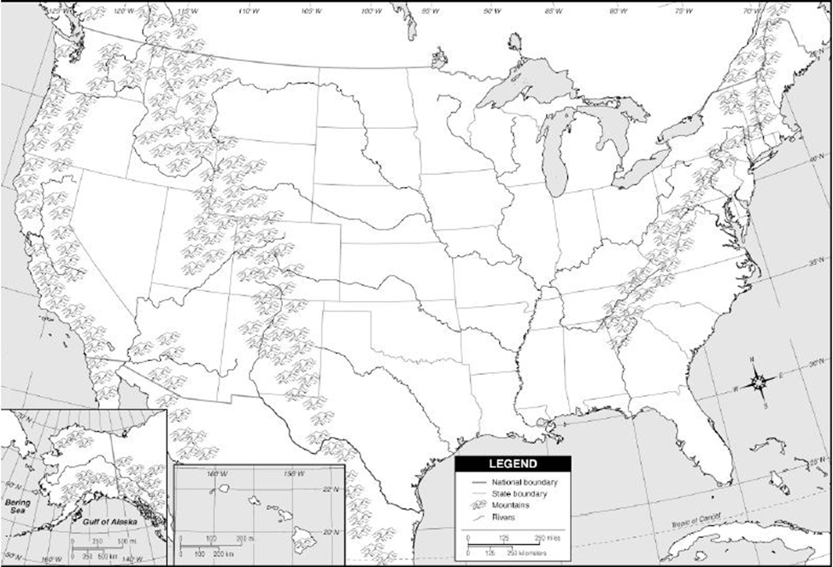

Slide 13
Map Activity
Directions: Get out your computers and at your tables work together to identify the following territorial gains on your map.
Louisiana Purchase
Florida Territory
Texas
Oregon Territory
California/Mexican Cession
Use different colored pencils of your choice to fill out these five territories. To help with this assignment type in US Territorial Gains in the Google search engine and click on images. At the end of the activity I will call on people to come up to the Smartboard and locate the territories.

Slide 15
That’s A Wrap: Pictures
Directions: I will show the pictures from the beginning of class once again. Now we will identify what territory these pictures were located in and whether or not these landmarks were there before the US took possession of these territories. You do not have to write the answers down. The purpose of this activity is to show that many famous landmarks in the US did not use to be part of the US until these territorial acquisitions were made. These pictures also show the US would be a much smaller nation without these territorial acquisitions.

Slide 16
Picture #1

Slide 17
Picture #2

Slide 18
Picture #3

Slide 19
Picture #4

Slide 20
Picture #5

