Slide 1
Social Studies Skill Builder
Nicholas Baker and Ben Spiers

Slide 2
Details of Method: Definition
Social Studies Skill builders involve students working on activities such as mapping, graphing, and analyzing primary sources (TCI p.38-39).

Slide 3
Details of Method: Steps from TCI
The teacher chooses an engaging skill that the students need to have practice on or learn (p.39-40).
The teacher provides a demonstration of the skill for the students to perform (p.41).
Students will be paired usually in groups of two (p.42).
Students perform the skill (p.43).
At the end of the activity the teacher will debrief with the class (p.44-45).

Slide 4
Benefits and Goals of the Method
Students learn an important skill or skills that may be a prerequisite toward learning another social studies concept.
These skills should be fun and engaging for students.

Slide 5
Factors to consider in design, implementation, and assessment of method
Give yourself enough time to plan for teaching the skill including: gathering resources, designing charts, maps, etc.
Many of these skill builders are good forms of formative assessment

Slide 6

Method Example #1

Slide 7
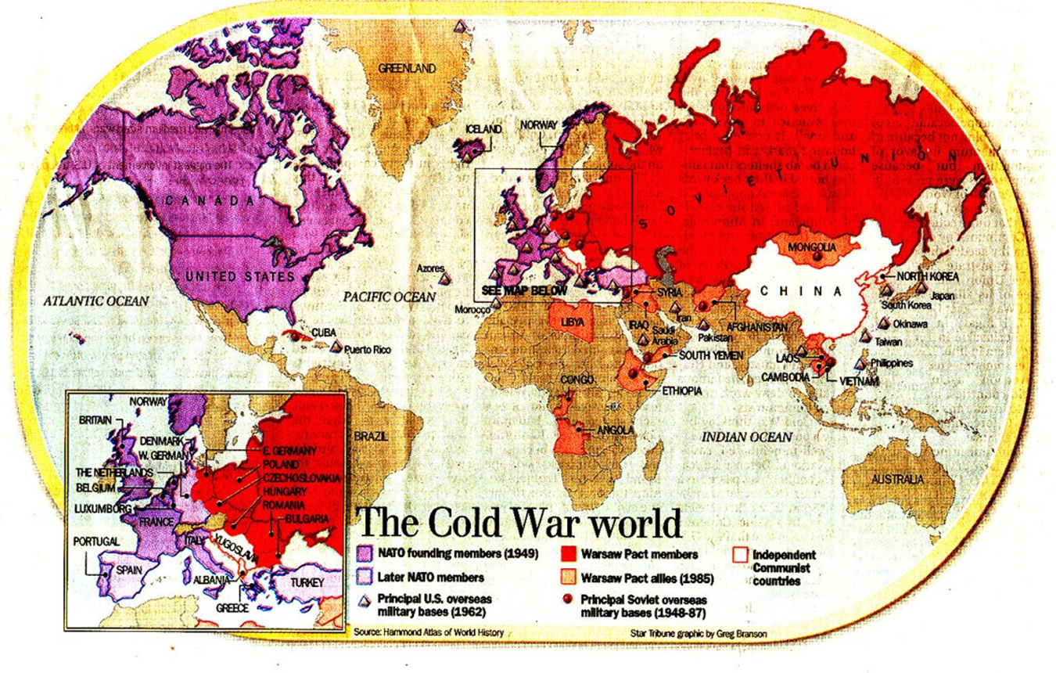
Method Example #1

Slide 8

Method Example #2

Slide 9
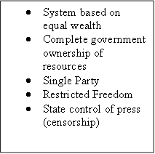
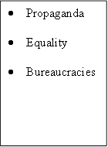
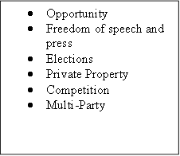
Method Example #2

Slide 10
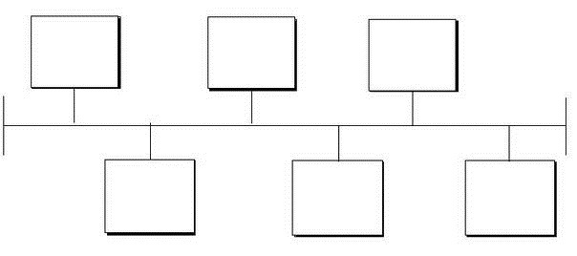
Method Activity: Timeline

Slide 11
Conclusion
Review
Questions?

