Slide 1
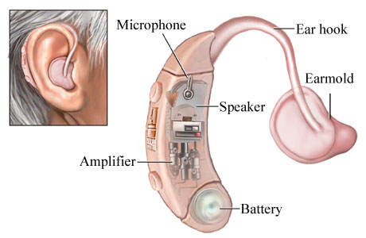
Hearing impairment technology for students
Hearing aids
Retrieved from: https://courses.cit.cornell.edu/psych431_nbb421/student2008/mjb249/Hearing%25252520Aids.html

Slide 2
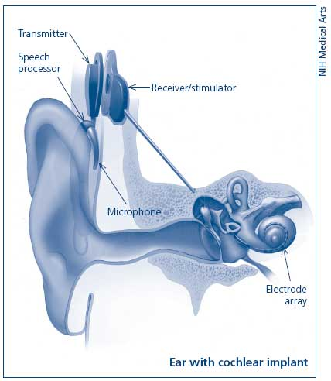
Cochlear Implant
Retrieved from: http://www.nidcd.nih.gov/health/hearing/pages/coch.aspx

Slide 3
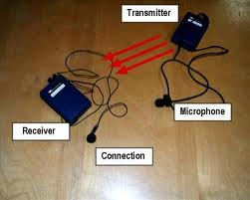
FM System
Retrieved from: http://www.deafhh.net/wp/2011/10/13/kids-and-hearing-assistive-listening-devices/

Slide 4
Common sense solutions
Visuals
Speak slowly and clearly
Speak facing the student
Have a note taker, or provide notes to the student
Have the student sit in front of the class
Minimize other noises and distractions in classroom
Source: http://www.nsnet.org/start/deaf.pdf

